Slide 1
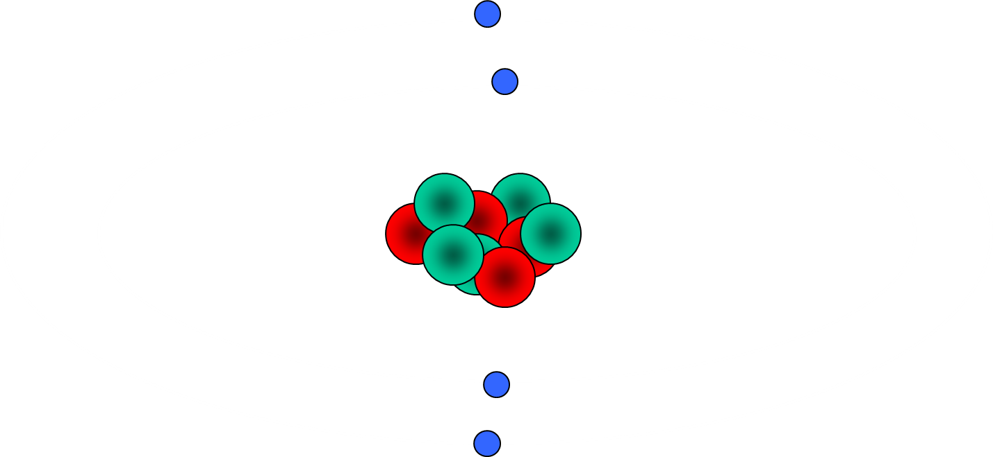
01/05/2020
Atomic Structure
2016 Physics topic 4
W Richards
Education Using PowerPoint

Slide 2
4.1 Atoms and Isotopes

Slide 3
The structure of the atom
01/05/2020
ELECTRON – negative, mass nearly nothing
The nucleus is around 10,000 times smaller then the atom!
PROTON – positive, same mass as neutron (“1”)
NEUTRON – neutral, same mass as proton (“1”)
An average atom is around 10⁻¹⁰m wide. The nucleus is around 10⁻¹⁵m wide.

Slide 4
Electron Orbits
01/05/2020
Here’s an atom of beryllium. Notice that the electrons go around the nucleus in different orbits:
9
Be
4

Slide 5
Changes in Orbit
We can change which energy level an electron is in by making the atom absorb light – the electron moves further away from the nucleus:
Light
The electron will also drop down an energy level (i.e. move closer to the nucleus) and give out light:
Light
Nucleus

Slide 6
The Charge of an Atom
01/05/2020
ELECTRON – negative, mass nearly nothing
Q. What is the charge on this atom?
PROTON – positive, same mass as neutron (“1”)
NEUTRON – neutral, same mass as proton (“1”)
Atoms always have the same number of protons and electrons so they are neutrally charged.

Slide 7
Facts about an Atom
01/05/2020
Particle | Relative Mass | Relative Charge
Proton | 1 | +1
Neutron | 1 | 0
Electron | 1/2000 (i.e. 0) | -1
MASS (nucleon) NUMBER = number of protons + number of neutrons
4
He
SYMBOL
2
PROTON NUMBER = number of protons (obviously)

Slide 8
Mass and atomic number revision
01/05/2020
How many protons, neutrons and electrons?
1
11
16
H
B
O
1
5
8
23
35
238
Na
Cl
U
11
17
92

Slide 9
Isotopes
01/05/2020
An isotope is an atom with a different number of neutrons:
Notice that the mass number is different. How many neutrons does each isotope have?
16
17
18
O
O
O
8
8
8
Each isotope has 8 protons – if it didn’t then it just wouldn’t be oxygen any more.

Slide 10
Ionisation
Atoms will turn into a positive ion if they lose an electron.
In this case, the ionisation was caused by radiation – we call this “ionising radiation”.

Slide 11
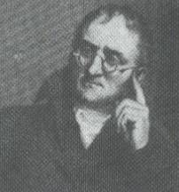
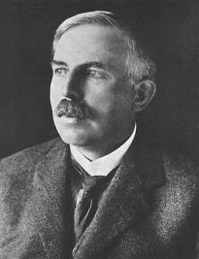
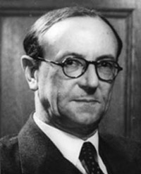
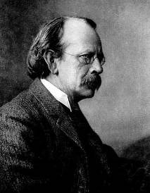
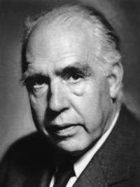
The Development of Atomic Structure Theory
Task: Find out how the following people have contributed to our understanding of atomic theory, including what they discovered and how their ideas were proved:
John Dalton
Ernest Rutherford
James Chadwick
JJ Thomson
Neils Bohr

Slide 12

The Development of Atomic Structure Theory
I proposed that all matter is made up of atoms – the smallest thing possible.
John Dalton
I discovered electrons and therefore proved that atoms can be made of smaller things
JJ Thomson
I showed that the atom was made of a small central nucleus with electrons orbiting it.
Ernest Rutherford
I showed that these electrons orbit at specific distances from the atom.
I showed that there are neutrons in the nucleus as well as protons.
Neils Bohr
James Chadwick

Slide 13

Structure of the atom
A hundred years ago people thought that the atom looked like a “plum pudding” – a sphere of positive charge with negatively charged electrons spread through it…
Ernest Rutherford, British scientist:
I did an experiment (with my colleagues Geiger and Marsden) that proved this idea was wrong. I called it the “Scattering Experiment”

Slide 14
The Rutherford Scattering Experiment
Alpha particles (positive charge, part of helium atom)
Thin gold foil
Most particles passed through, 1/8000 were deflected by more than 90⁰
Conclusion – atom is made up of a small, positively charged nucleus surrounded by electrons orbiting in a “cloud”.

Slide 15
4.2 Atoms and Nuclear Radiation

Slide 16
Introduction to Radioactivity
Some substances are classed as “radioactive” – this means that they are unstable and continuously give out radiation at random intervals in a process called “radioactive decay”:
Radiation
The amount of radioactive decays happening per second is called the “activity” of a sample and is measured in Becquerels (Bq). Activity can be measured using a Geiger-Muller tube.

Slide 17
Types of radiation
01/05/2020
1) Alpha (α) – an atom decays into a new atom and emits an alpha particle (2 protons and 2 ______ – the nucleus of a ______ atom)
Unstable nucleus
New nucleus
Alpha particle
2) Beta (β) – a neutron turns into a _______ and electron. The fast moving, high energy electron is called a _____ particle.
Beta particle
Unstable nucleus
New nucleus
3) Gamma (γ) – surplus _____ is sometimes emitted. This is called gamma radiation and has a very high ______ with short wavelength. The atom is not changed.
Unstable nucleus
Less energetic nucleus
Gamma radiation
4) Neutrons (n) – sometimes free neutrons are emitted as a result of nuclear fission or _____ .
Words – frequency, proton, fusion, energy, neutrons, helium, beta

Slide 18
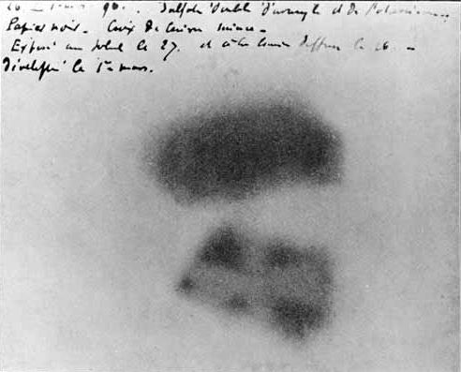
Ways to detect radioactivity
1) The Geiger Muller Tube
2) Photographic film
This photo shows how radioactivity was discovered in 1896

Slide 19
Blocking Radiation
Each type of radiation can be blocked by different materials:
α
β
γ
Sheet of paper (or 6cm of air will do)
Few mm of aluminium
Few cm of lead

Slide 20
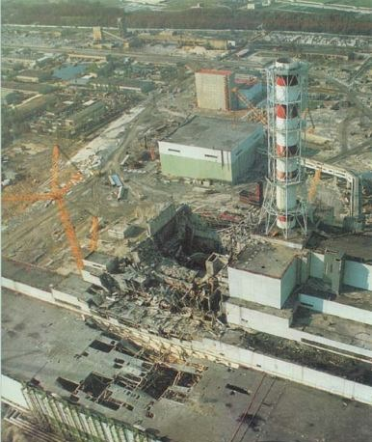
Chernobyl

Slide 21
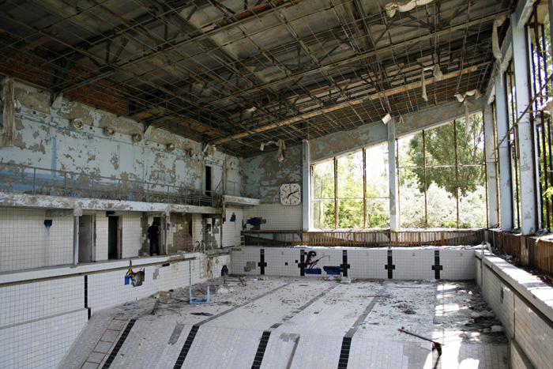
Chernobyl

Slide 22
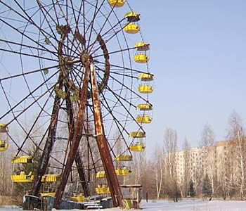
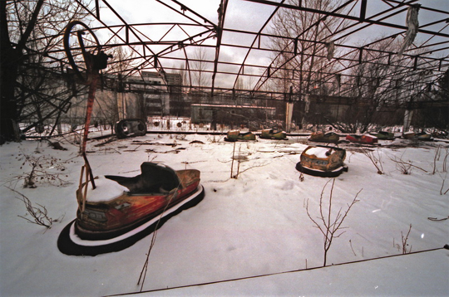
Chernobyl

Slide 23
Summary
Property | Alpha | Beta | Gamma
Charge
Mass
Penetration ability
Range in air
What is it?
Ionising ability

Slide 24
Nuclear Equations
Alpha decay:
241
237
4
Am
Np
+
He
95
93
2
Beta - decay:
90
90
0
e
Sr
Y
+
38
39
-1
Q. What about gamma decay? Can we write an equation for it?

Slide 25
A radioactive decay graph
01/05/2020
Activity (Bq)
“1 Becquerel” means “1 radioactive count per second”
Time

Slide 26
Half life
The HALF-LIFE of an atom is the time taken for HALF of the radioisotopes in a sample to decay. In other words, the activity of the sample (in Bq) will halve after 1 half life:
= radioisotope
= new atom formed
After 1 half life half have decayed (that’s 8)
After 2 half lives another half have decayed (12 altogether)
After 3 half lives another 2 have decayed (14 altogether)
At start there are 16 radioisotopes

Slide 27
Half Life
Activity (in Bq)
Notice that, although radioactive decay is random and cannot be predicted, you can get a good idea of how many have decayed by plotting a graph like this.
Time
1 half life
1 half life
1 half life

Slide 28
Half Life questions
What sample (in %) of a radioactive isotope will have decayed after two half lives?
What % of a radioactive sample will be undecayed after 3 half lives?
If 7/8 of a sample has decayed after 6 days, what was the half life of the sample?
Uranium has a half life of 4,000,000,000 years. If a sample of rock (originally all uranium) now only contains 1/8th uranium, how old is it?
75%
12.5%
2 days
12bn years

Slide 29
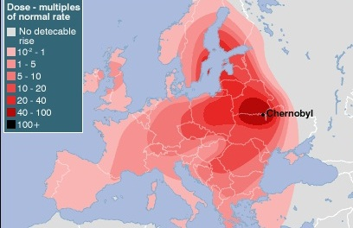
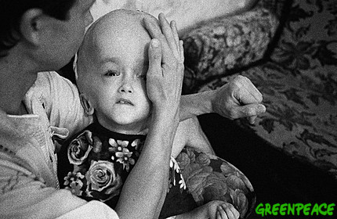
Contamination and Irradiation
“Contamination” means when something has been contaminated with a radioactive isotope. For example, when the Chernobyl power station exploded in 1986 and contaminated the land:
“Irradiation” is when cells or atoms are damaged by radioactivity, causing cancer or cell mutation:
Which one would you be more worried about and why?

Slide 30
4.3 Hazards and uses of radioactive emissions and of background radiation (Physics only)

Slide 31
Background Radiation
01/05/2020
Background radiation is radiation that is all around us and has been there ever since you were born. Some example sources:
13% are man-made
Radon gas
Food
Cosmic rays
Gamma rays from rocks and buildings
Medical
Nuclear power

Slide 32
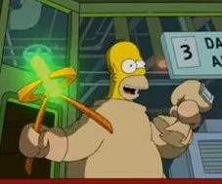
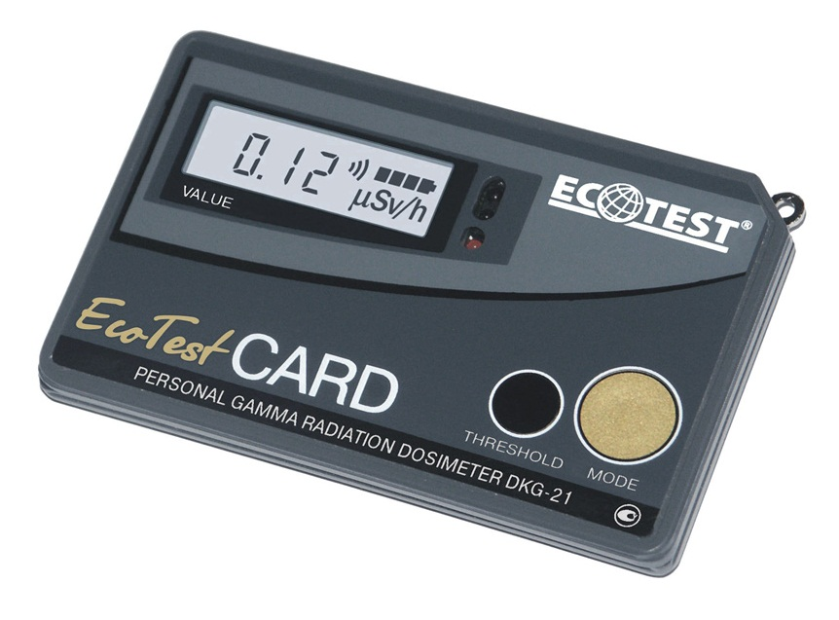
Exposure to Radiation
People like me work with radiation a lot so we need to wear a “dosimeter” to record our exposure to radiation:
This is because ionising radiation can cause cell mutation, cancer or leukaemia so doses need to be recorded.
Radiation dose is measured in sieverts (Sv).

Slide 33

Using Radioactivity in Medicine 1 - Tracers
01/05/2020
A tracer is a small amount of radioactive material used to detect things, e.g. a leak in a pipe:
The radiation from the radioactive source is picked up above the ground, enabling the leak in the pipe to be detected.
Gamma source
The same principle is used for tracers in medicine to detect tumours:
Q. For medicinal tracers, you would probably use a beta or gamma source with a short half life – why?
Q. What are the benefits and drawbacks of applying radiation internally and externally?

Slide 34
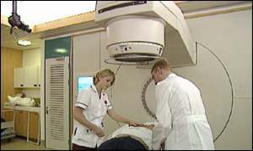
Using Radioactivity in Medicine 2- Treating Cancer (“Radiotherapy”)
High energy gamma radiation can be used to unwanted tissue (i.e. cancerous cells). However, care must be taken in order to ensure that the gamma radiation does not affect normal tissue as well.

Slide 35
4.4 Nuclear Fission and Nuclear Fusion (Physics only)

Slide 36
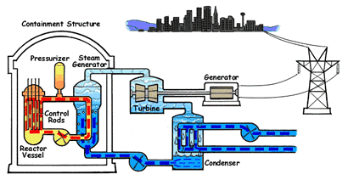
Nuclear power stations
Nuclear power stations use reactions called “nuclear fission” reactions to generate energy:

Slide 37
Nuclear fission
01/05/2020
More neutrons and gamma rays
Nuclear fission is the splitting a large unstable nucleus to release energy and smaller products with kinetic energy:
Neutron
Unstable nucleus
Uranium-235 nucleus
New nuclei roughly equal in size

Slide 38
Chain reactions
01/05/2020
Each fission reaction releases neutrons that could be used in further reactions – a “chain reaction”:

Slide 39
Fission in Nuclear power stations
How are control rods used to control the rate of these reactions?
These fission reactions occur in the fuel rods and they become very hot. Control rods are moved in and out in order to absorb neutrons and control the reaction.
A nuclear bomb is basically an uncontrolled chain reaction.

Slide 40
Nuclear Fusion in stars
01/05/2020
Proton
Neutron
Nuclear fusion basically combines smaller nuclei to make larger nuclei. During nuclear fusion some of the mass may be converted into energy – that’s how we get energy from our sun.

